Slide 1
Promoting “One Health” Education in Thai Border Schools
SEAMEO TROPMED Network

Slide 2
Purpose of the WP
To report to the CDM 2021:
- new project of SEAMEO TROPMED Network
- in collaboration with SEAMEO STEM-ED, Southeast Asia One Health University Network (SEAOHUN) and CHEVRON.

Slide 3
Background
One Health”
- underscores the interconnectedness and interdependence between humans and animals and with their shared environment

Slide 4
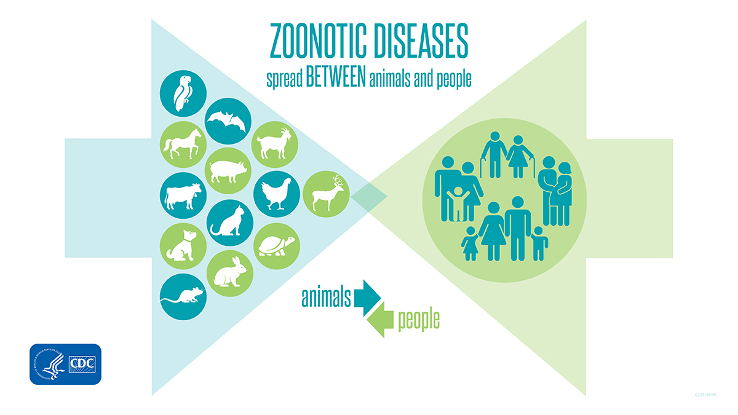
Background
Bird flu,
Ebola,
Zika
COVID-19

Slide 5
Scope
“Strengthening One Health Education in Southeast Asia”
- Strengthening One Health University Networks - SEAOHUN
- Applying One Health to Solve Community Health Issue - Tropical Disease Research Center of Khon Kaen University
- Promoting One Health in Thai Border School – SEAMEO TROPMED Network, STEM-Ed

Slide 6
Purpose:
Promote the concepts of “One Health” among students and school officials/teachers in selected border schools
Objectives:
Develop competencies of teachers on the promotion of One Health concepts.
Enhance knowledge, and develop positive attitudes and behaviors related to One Health and other health concerns among students.
Collaborate with different groups in the community for the promotion of the One Health concept.

Slide 7
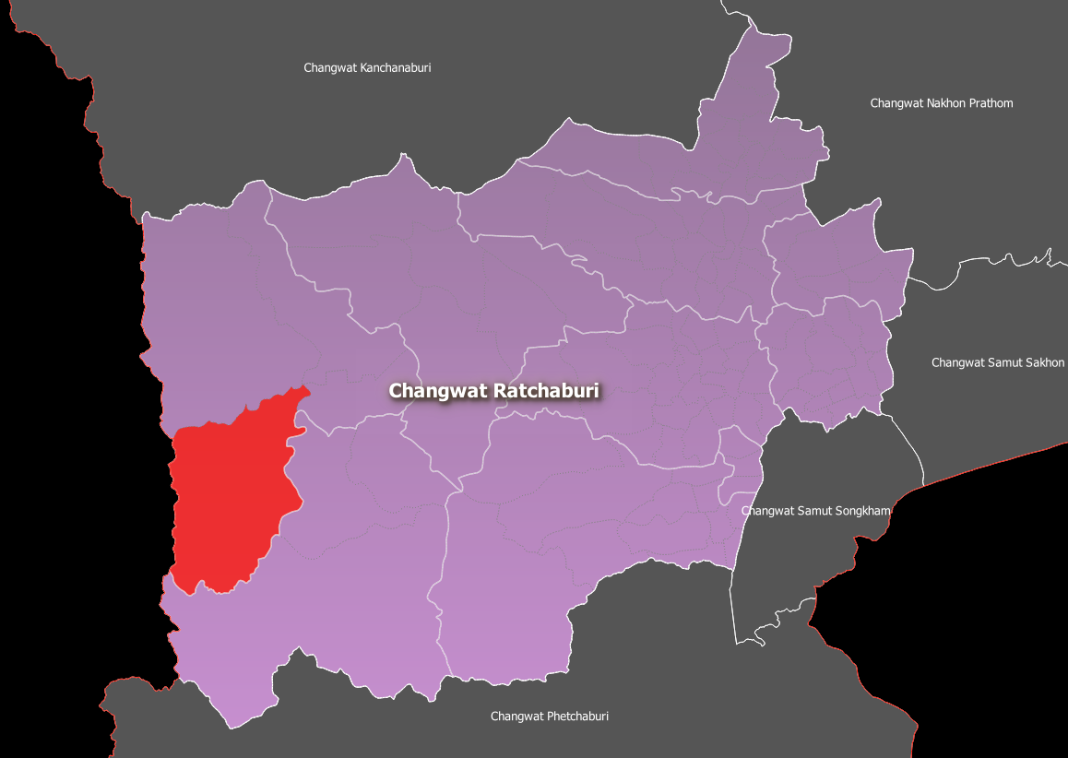
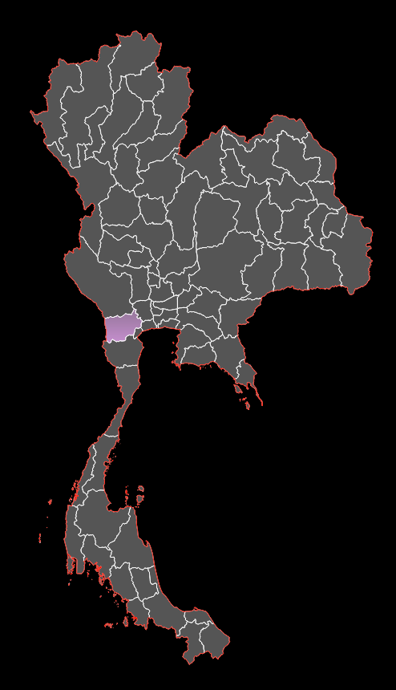
Study site
Tanawsri sub-district: (Ratchaburi )
- borders with Myanmar on its west side
- population of about 15, 600
- 7 villages ( 2 with informal border crossings with Myanmar)

Slide 8
Major Activities
Social preparation of the selected border schools and communities
Development of Modules for Teachers
Health Assessment of School Children
Treatment of Soil-Transmitted Helminthiasis and Anemia
Training of teachers
Curricular mainstreaming
Co-curricular activities for students
Community Engagement
Monitoring and Evaluation

Slide 9
Implication
“One Health” concept - consistent with
SDG 3 (Good Health and Well-being)
SDG 4 (Quality Education)
SDG 6 (Clean Water and Sanitation)
SDG 17 (Partnerships)
The project is also consistent with SEAMEO Priority Areas:
# 2 (Addressing Barriers to Inclusion)
# 3 (Resiliency in the Face of Emergencies)

Slide 10
Implication..
Children usually associate closely with animals - a need for preventive education against zoonotic diseases
School plays a key role in the early development of positive attitude and behaviours
Students can bring these concepts to home and to the greater community

Slide 11
Implication
Border schools
mobility of both human and animals across
humans and animals live close with each other
project aims to reach underprivileged and under-reached population
Funding:
CHEVRON
SEAMEO TROPMED Network
SEAMEO STEM ED – Advisory

Slide 12
Justification
Outputs of the project:
“One Health” related modules for use of the teachers
Teachers trained in curricular mainstreaming One Health related concepts
School children receive One Health education
Decrease in the prevalence of Soil-transmitted helminthiasis and Anemia among school children
Policy brief on One Health

Slide 13
Requested Decision
The SEAMEO Centre Directors Meeting 2021 is requested to take note of this “One Health Promotion Project of SEAMEO TROPMED Network.

