Slide 1
Promoting One Health education in border schools
SEAMEO TROPMED Network

Slide 2

SEAMEO TROPMED / STEM-ED Project team
Dr. Panamas Maneekan
Administrative Officer
Field Coordinator
Mr. Irwin Chavez
Statistician
Ms. Pornpimol Chaivittayangkul
Dr. Kessara Amornvuthivorn
Project advisor
Dr. Sandra Tempongko
Project Co-Leader
Dr. Pratap Singhasivanon
Project Leader
Mrs. Parinda Chomming
  Finance Officer

Slide 3
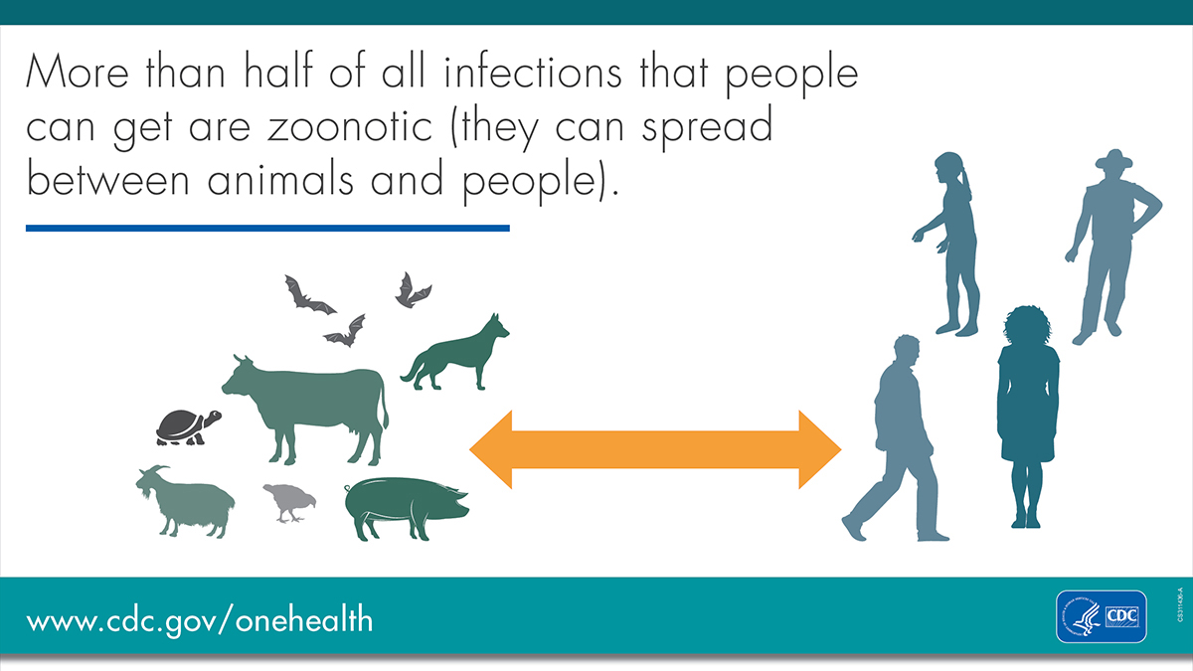
Rationale
Growing understanding of Interconnectedness of human, animal and environmental health
Emergence of the zoonotic diseases:
  SARS - 2002-2003 - Civet cats, bats
  West African Ebola epidemic –2015 - fruit bats were considered to be the reservoir
  New Influenza A (H1N1) – “swine flu” 2009 – pandemic
  MERS-CoV
  HIV
  COVID-19

Slide 4

One Health Concept
a collaborative, multisectoral, and trans-disciplinary approach
working at local, regional, national, and global levels
to achieve optimal health and well-being outcomes recognizing the interconnections between people, animals, plants and their shared environment.

Slide 5
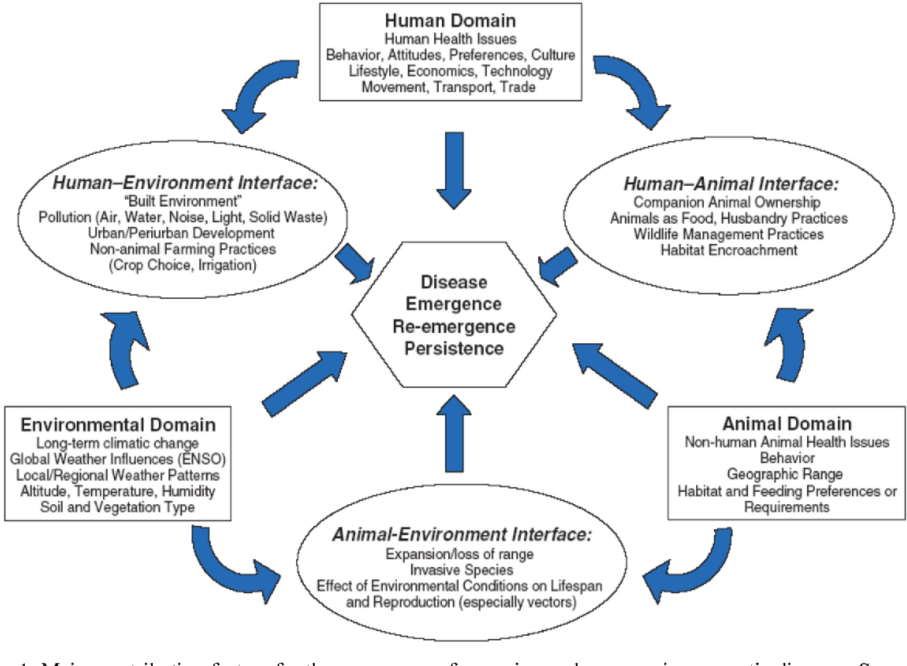
One Health ….
Tackles global issues:
- emerging infectious diseases
- environmental contamination,
- deforestation
- habitat use conflicts,
- biodiversity loss,
- antimicrobial resistance
- mobility of commodity and people
- climate change

Slide 6
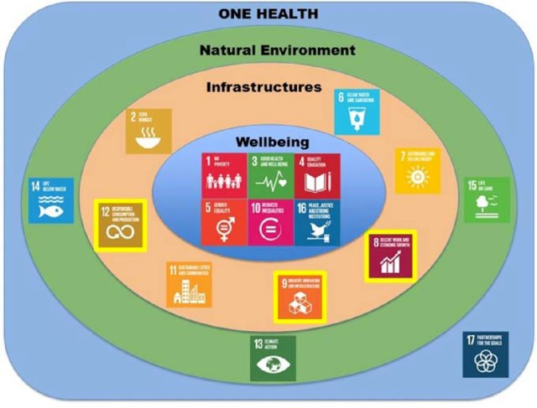
Rationale
      “One Health” concept is consistent with :
Adapted from Waage et al
Uploaded by J. N. Garnier

Slide 7

One Health Education
SEAMEO 7 Priority Areas
Global Priority in Education : Global Citizenship

Slide 8
Current Efforts on the Promotion of One Health in SEA
MOH – training of health professionals
SEAOHUN
THOHUN - education; research, community extension ( curricular integration is primarily on higher education)
“ aims to train the current and future workforce across sectors
(e.g. human health, animal health, environmental health)
and disciplines (e.g. medicine, public health, epidemiology, agriculture, ecology”

Slide 9

Why educate children with One Health concept
Children - one of the most vulnerable populations for zoonotic diseases:
    developing immune systems,
    lack of awareness,
    close contact with animals specially the companion animals
Studies have shown that attitudes and long –term behaviours are developed early in life

Slide 10

Why One Health in the School Setting
Sustainable development starts with safe, healthy and educated children
(UNICEF, 2013)

Slide 11

Schools…
Best setting to promote the development of positive attitude and behaviours early in life
Have the potential to make significant and long lasting contributions to promoting healthy habits in children and adolescents
Students can influence parents and the greater community
Complements the work of professionals/ community –based efforts
OH is multisectoral,multidisciplinary …
SCHOOLS HAVE A ROLE TO PLAY

Slide 12

Why the border School?
Mobility of people and animals
Humans and animals live close with each other
Reaching the under-privileged and under-reached population

Slide 13

Purpose/ Objectives
  Promote the concepts of One Health among students and school
officials/teachers in a selected border school
    Develop competencies of teachers on the promotion of concepts of “One Health”;
    Enhance knowledge and development of positive attitude and behaviours related to “One Health” and other health-related concerns among students;
    Collaborate with the different groups in the community for the promotion of One Health concept.
NOTE: The experience will enable the upscaling and roll out of this program to SEA

Slide 14
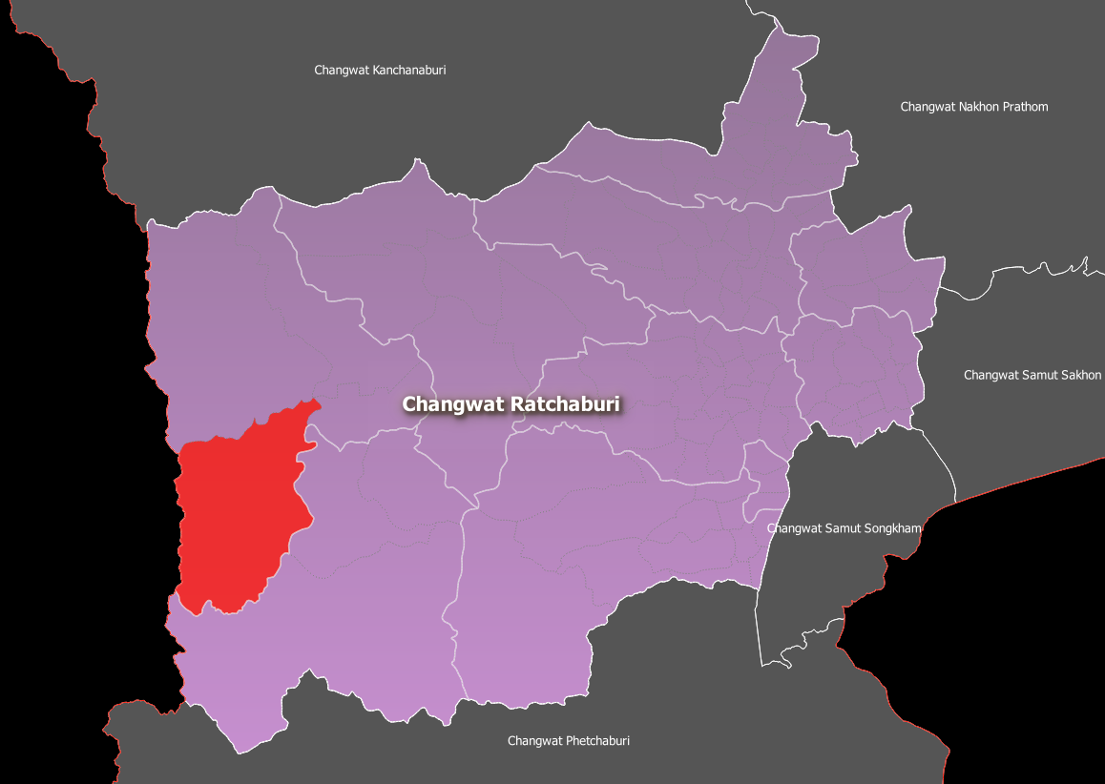
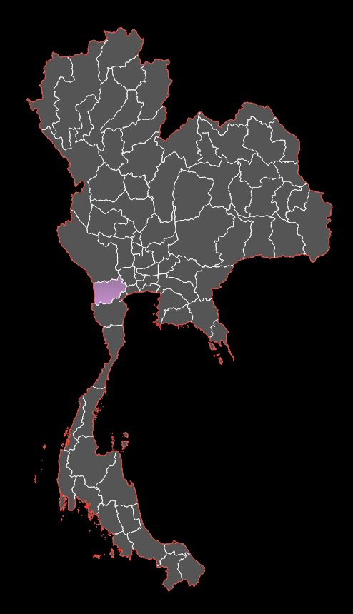
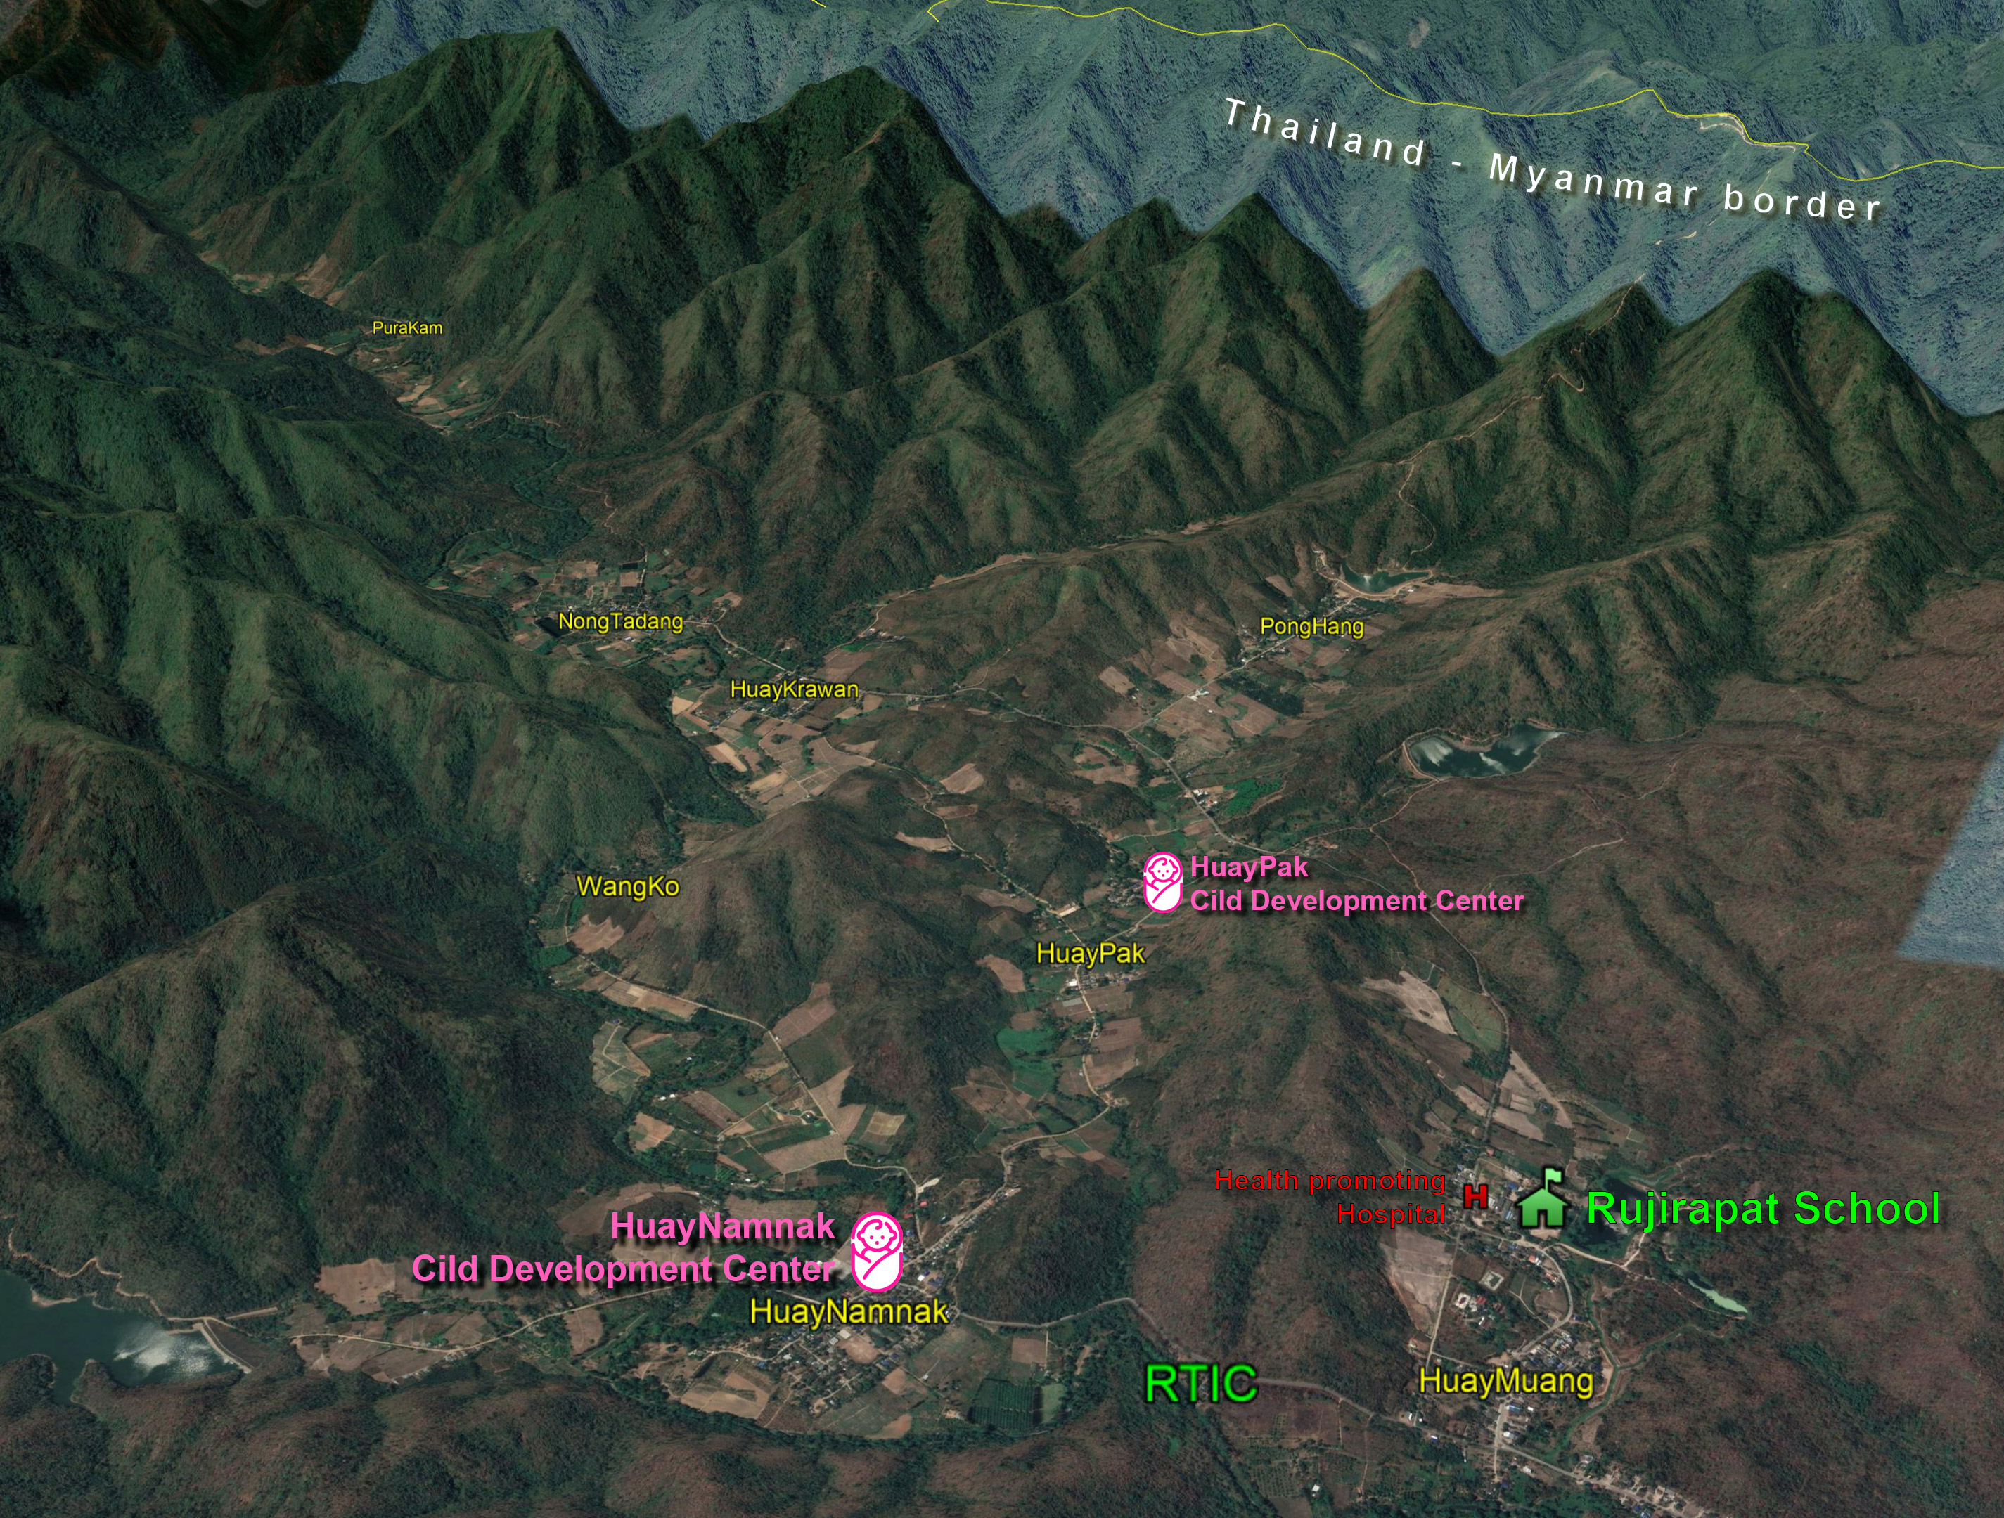
Study site
Tanawsri sub-district:
- borders with Myanmar on its west side
- population of about 15, 600
- 7 villages ( 2 with informal border crossings with Myanmar)
- 4 schools under the MOE
- 2 Child Development Centers under the Local administration
- Health Promoting Hospital
- 4 Projects (Royal Initiative)
- Rajanagrindra Tropical Disease International Centre

Slide 15
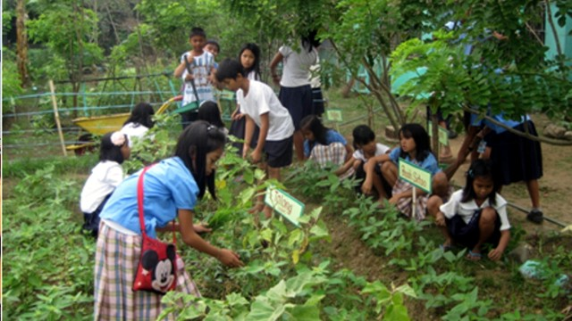
Components of the Project
  Module Development
  Training of teachers
  Partnership
  Curricular mainstreaming
  Co-curricular activities
  Health Assessments of students
  Provision of basic health services including referral
  Engagement of communities
  Monitoring/Mid-term Review
  Evaluation
  Documentation

Slide 16
Major partners
    At the National level:
    - Ministry of Education/ Bureau of International Cooperation
    - Ministry of Health/CDC
    - Bureau of Livestock Industry
    Provincial/District Levels
    - School Officials
    - Community
- Local Administration Office
    - Provincial Hospital
    - Health Promoting Hospital
    - RTIC
    - THOHUN

Slide 17
Project key deliverables and timeline
Deliverables | Time
Final Plan of the Project | 1st Year – 2 weeks after Kick off
Modules developed | - Q1
Teachers Training Manual/ Proceedings of training | - Q3
Pre-Test of students | - Q 3
Health Assessment Baseline
Monitoring/ Progress Report: - Curricular Integration - Community Engagement - Referral to health services facilities - Co-curricular activities | - Quarterly for the duration of the project
Post Test/Health Assessment Assessment/ | 2nd year Q3
Final Report | 2nd year Q4

Slide 18
Support Chevron may offer
Expert on Integration of One Health in Basic Education

